Slide 1
COS-209 Final Project
PrizeMania Program
By Aung Min Khant, ID-00732

Slide 2
Content of our System
System Overview
Diagram of the whole system (Use Case)
ER Diagram
Sequence Diagram
Activity Diagram
System Testing
Q & A Section
Appreciation

Slide 3

Overview of the System
To create a web application for people
To participate an online lucky draw program
To get high value demanding electronic devices with an affordable ticket price
Can easily access to our page with easy registration

Slide 4
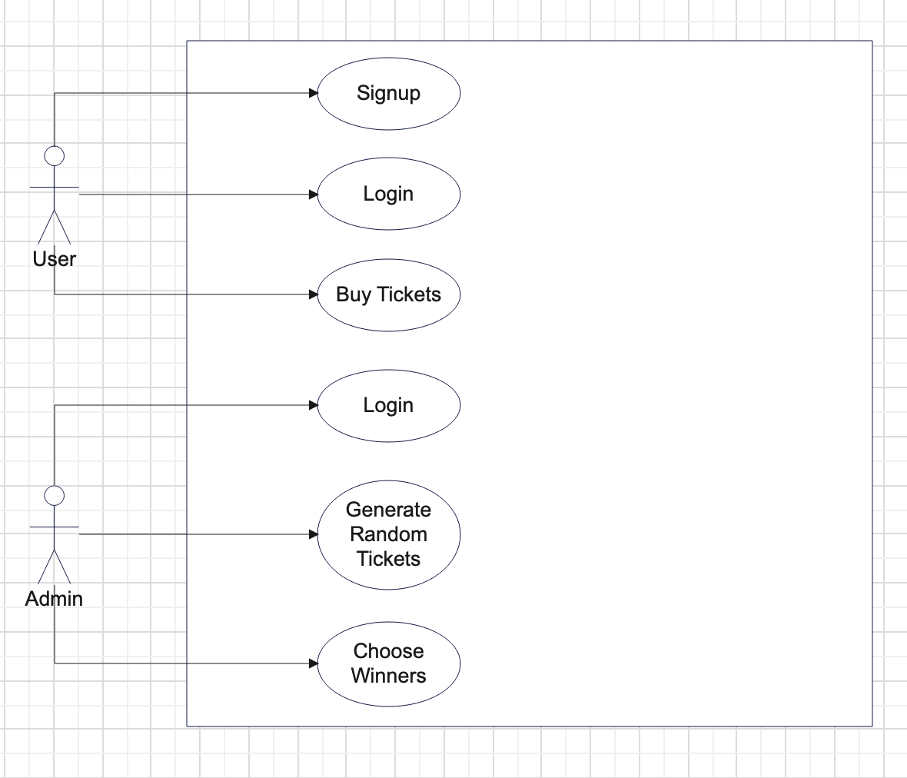
The whole system Diagram

Slide 5
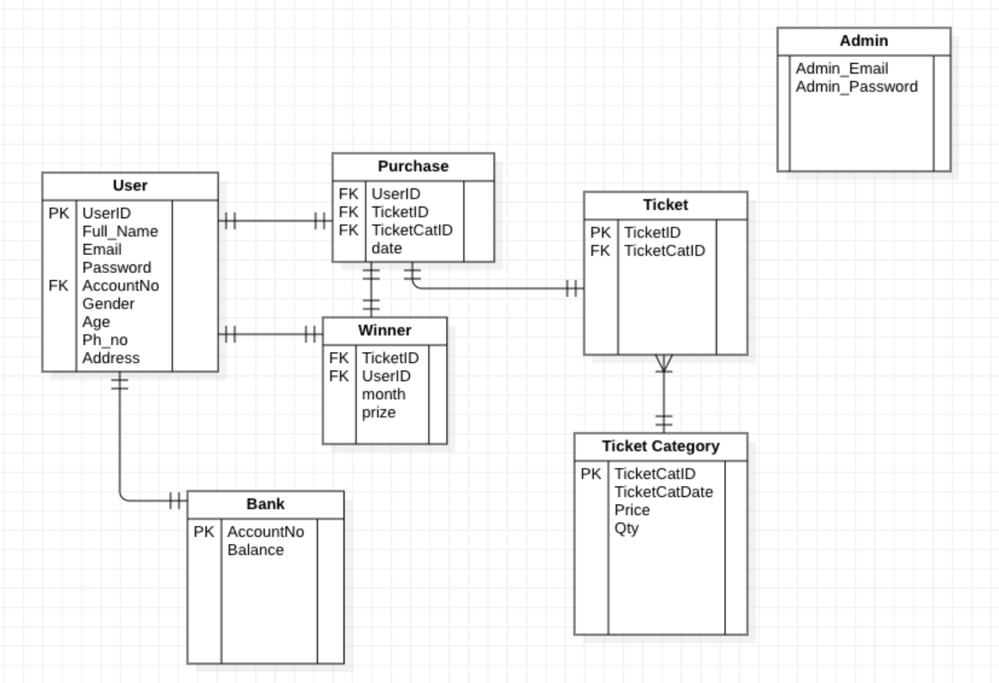
ER Diagram

Slide 6
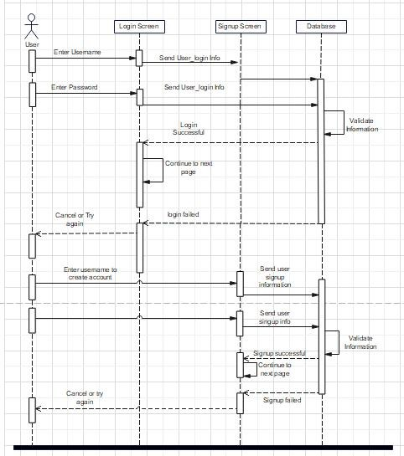
Sequence Diagram

Slide 7
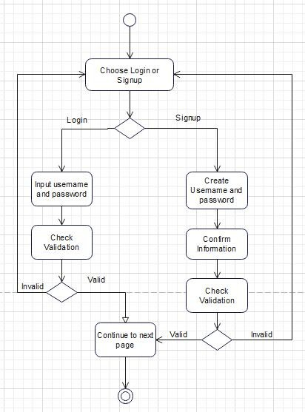
Activity Diagram

Slide 8
System Testing…

Slide 9

Question And Answer Section

Slide 10


